Slide 1
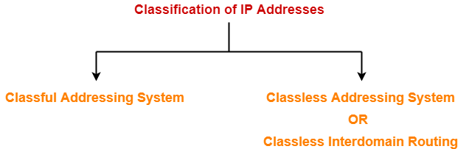

Slide 2
IP address is an address having information about how to reach a specific host, especially outside the LAN. An IP address is a 32 bit unique address having an address space of 2³².

Slide 3

Note
An IPv4 address is 32 bits long.

Slide 4
Note
The IPv4 addresses are unique and universal.

Slide 5
Note
The address space of IPv4 is
₂32
or 4,294,967,296.

Slide 6
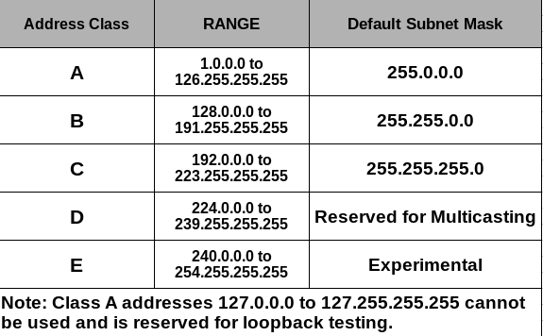

Slide 7
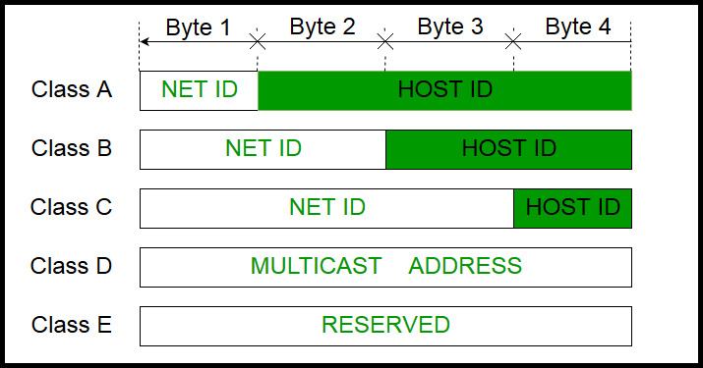
IPv4 address is divided into two parts Network ID Host ID

Slide 8
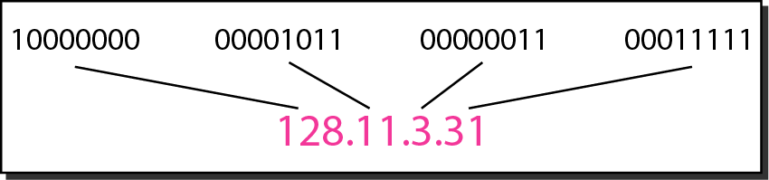
Figure 19.1 Dotted-decimal notation and binary notation for an IPv4 address

Slide 9
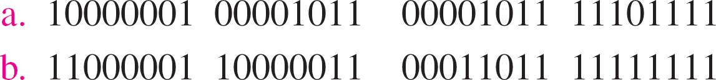
Change the following IPv4 addresses from binary notation to dotted-decimal notation.
Example 19.1
Solution
We replace each group of 8 bits with its equivalent decimal number (see Appendix B) and add dots for separation.
????
????

Slide 10
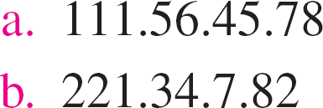
Change the following IPv4 addresses from dotted-decimal notation to binary notation.
Example 19.2

Slide 11
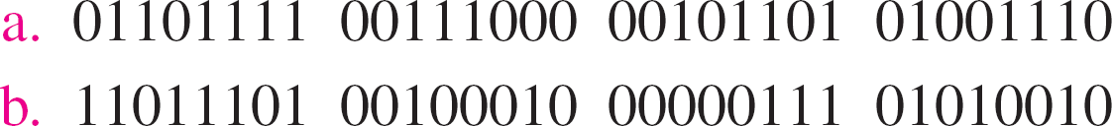
Solution
We replace each decimal number with its binary equivalent (see Appendix B).

Slide 12



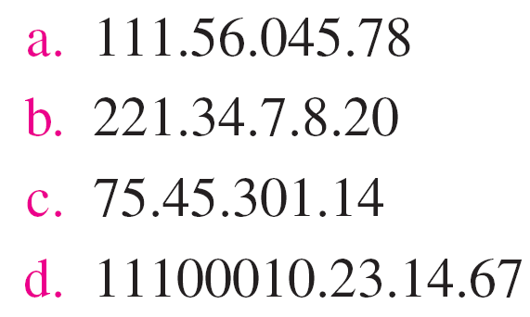
Find the error, if any, in the following IPv4 addresses.
Example 19.3

Slide 13
Note
In classful addressing, the address space is divided into five classes: A, B, C, D, and E.

Slide 14
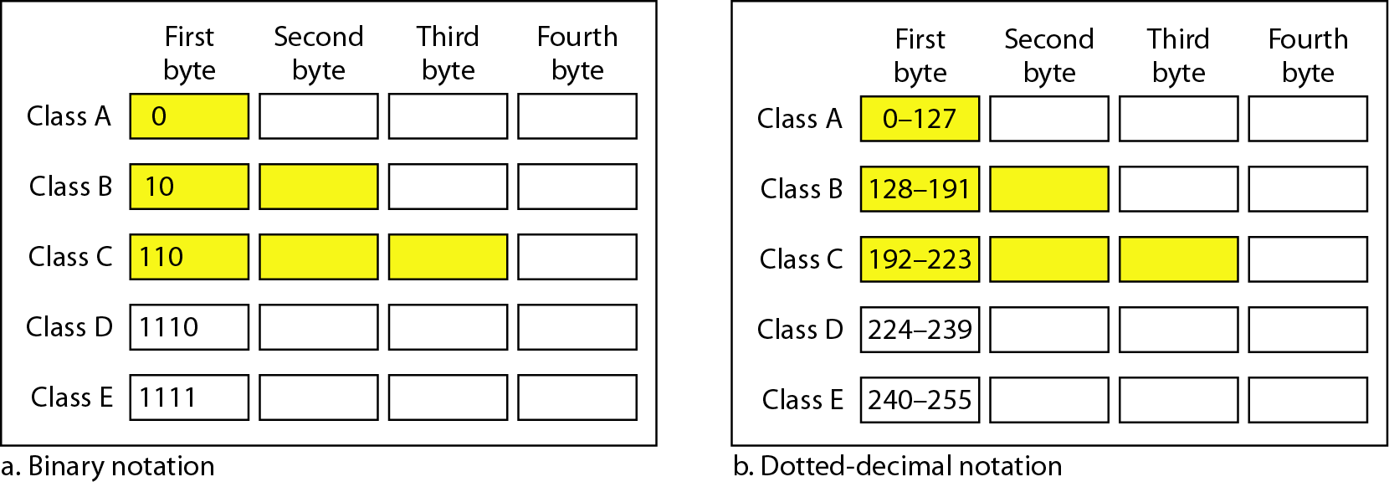
Figure 19.2 Finding the classes in binary and dotted-decimal notation

Slide 15
Find the class of each address.
Example 19.4
a. 00000001 00001011 00001011 11101111
b. 11000001 10000011 00011011 11111111
c. 14.23.120.8
d. 252.5.15.111

Slide 16
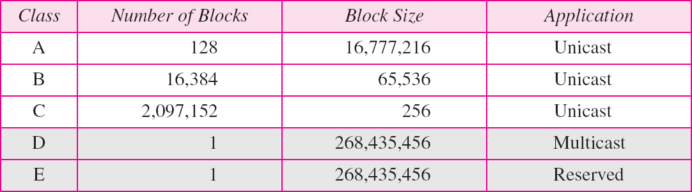
Table 19.1 Number of blocks and block size in classful IPv4 addressing

Slide 17
Note
In classful addressing, a large part of the available addresses were wasted.

Slide 18
CIDR
(Classless Inter-Domain Routing) -- also known as supernetting -- is a method of assigning Internet Protocol (IP) addresses that improves the efficiency of address distribution and replaces the previous system based on Class A, Class B and Class C networks.
Classless Inter-Domain Routing (CIDR), also called supernetting, is a way to more flexibly allocate Internet Protocol (IP) addresses by creating unique and more granular identifiers for networks and individual devices.

Slide 19
CIDR is based on variable-length subnet masking (VLSM), which enables network engineers to divide an IP address space into a hierarchy of subnets of different sizes, making it possible to create subnetworks with different host counts without wasting large numbers of addresses.

Slide 20
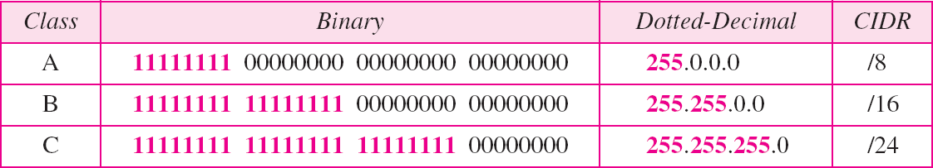
Table 19.2 Default masks for classful addressing

Slide 21
CIDR addresses are made up of two sets of numbers: a prefix, which is the binary representation of the network address -- similar to what would be seen in a normal IP address -- and a suffix, which declares the total number of bits in the entire address.
For example, CIDR notation may look like: 192.168.129.23/17 -- with 17 being the number of bits in the address. IPv4 addresses allow a maximum of 32 bits.

Slide 22
Computer networks can be broken into many networks or small networks can be combined to form large networks depending upon our needs.
This is done by
IP subnetting
Supernetting

Slide 23
Why subnetting?
Suppose we take a network of class A. So, in class A, we have 2²⁴ hosts. So to manage such a large number of hosts is tedious. So if we divide this large network into the smaller network then maintaining each network would be easy.

Slide 24

Addressing Limitations
192.168.2.0/24
192.168.1.0/24
20 Hosts
30 Hosts
192.168.3.0/24
10 Hosts
Network design using the default subnet mask results in address wastage.

Slide 25
How does subnetting work?
Suppose we have a class C network having network ID as 201.10.1.0(range of class C 192–223). So the total number of hosts is 256(for class C host is defined by last octet i.e. 2⁸). But, the total usable host is 254. This is because the first IP address is for the network ID and the last IP address is Direct Broadcast Address(for sending any packet from one network to all other hosts of another network).

Slide 26
Note
Classful addressing, which is almost obsolete, is replaced with classless addressing.

Slide 27
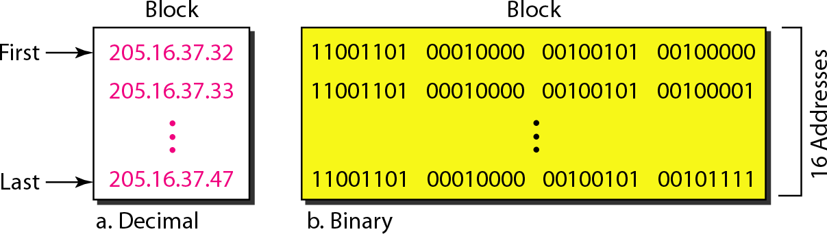
Figure 19.3 A block of 16 addresses granted to a small organization

Slide 28
Subnet Mask
Network
Host
192.168.1
0
11000000.10101000.000000001
00000000
Subnet
255.255.255
0
11111111.11111111.11111111
00000000
Subnet masks distinguish between the binary values that represent each (sub)network and those that represent each host.
Page 28
Notes:
The identification of a unique network segment is governed by the implementation of a mask value that is used to distinguish the number of bits that represent the network segment, for which the remaining bits are understood as representing the number of hosts supported within a given network segment. A network administrator can divide a network address into sub-networks so that broadcast packets are transmitted within the boundaries of a single subnet. The subnet mask consists of a string of continuous and unbroken 1 values followed by a similar unbroken string of 0 values. The 1 values correspond to the network ID field whereas the 0 values correspond to the host ID field.

Slide 29
Default Subnet Mask
Class A
255
0
0
0
255
255
0
0
Class B
Class C
255
255
255
0
Certain subnet masks are applied to address ranges by default to denote the fixed range that is used for each network class.
Notes:
For each class of network address, a corresponding subnet mask is applied to specify the default size of the network segment. Any network considered to be part of the class A address range is fixed with a default subnet mask pertaining to 8 leftmost bits which comprise of the first octet of the IP address, with the remaining three octets remaining available for host ID assignment.
In a similar manner, the class B network reflects a default subnet mask of 16 bits, allowing a greater number of networks within the class B range at the cost of the number of hosts that can be assigned per default network. The class C network defaults to a 24 bit mask that provides a large number of potential networks but limits greatly the number of hosts that can be assigned within the default network. The default networks provide a common boundary to address ranges, however in the case of class A and class B address ranges, do not provide a practical scale for address allocation for Ethernet based networks.

Slide 30
Address Planning
IP Address
192
168
1
7
Subnet Mask
255
255
255
0
11000000 10101000 00000001 00000111
11111111 11111111 11111111 00000000
Network Address
(Binary)
11000000 10101000 00000001 00000000
Network Address
192
168
1
0
Host Addresses: 2^{n}
256
Valid Hosts: 2^{n} - 2
254

Slide 31
Case Scenario
IP Address
172
16
1
7
Subnet Mask
255
255
0
0
Network Address
?
?
?
?
Host Addresses: 2^{n}
?
Valid Hosts: 2^{n} - 2
?
Determine the network for the given IP address, and the number of actual, and valid host addresses in the network.

Slide 32
Which of the subnet masks we can use for a corporate network with 300 sub-networks and a maximum of 50 host addresses per subnet and working with only Class B address.

Slide 33
ANS:] /25 = 255.255.255.128 and /26 = 255.255.255.192
Explanation:] Given that we need to subnet class “B” network.
Required Number of Subnets: 300
And, Maximum of Host address per subnet is: 50
To fulfill these requirements, we can use two combinations of NW bits and Host bits i.e. we can use 2 different Subnet Masks.
Class “B”: Default Subnet Mask /16 = 255.255.0.0
For 300 Subnets we need to Borrow 9 bits such as, 29 = 512 > 300.
Hence, Network bits = 16 + 9 = 25
Therefore, Host Bits = 32 – 25 = 7
Maximum of Host address available = 27 – 2 = 126 > 50
Means, both of the requirements are fulfil. So we can use CIDR /25 i.e. Subnet mask 255.255.255.128.
For 300 Subnets we need to Borrow 10 bits such as, 210 = 1024 > 300.
Hence, Network bits = 16 + 10 = 26
Therefore, Host Bits = 32 – 26 = 6
Maximum of Host address available = 26 – 2 = 64 > 50
Means, both of the requirements are fulfil. So we can use CIDR /26 i.e. Subnet mask 255.255.255.192.

Slide 34
An organization requires a range of IP addresses to assign one to each of its 1500 computers. The organization has approached an Internet Service Provider (ISP) for this task. The ISP uses CIDR and serves the requests from the available IP address space 202.61.0.0/17. The ISP wants to assign address space to the organization which will minimize the number of routing entries in the ISP’s router using route aggregation. To calculate the address spaces are potential candidates from which the ISP can allow any one of the organizations?

Slide 35
Subnet Mask for the given IP address:
202.61.0.0/17
⇒ 11111111 11111111 10000000 00000000
⇒ 255.255.128.0
Now, since we need 1500 hosts, so, bits for host address,
= ceiling (log₂ (1500))
= ceiling (10.55)
= 11 bits for host address
So, the last 11 bits will be for host addresses:
00000000.00000000 → 00000111.11111111 (0.0 → 7.255) 00001000.00000000 → 00010000.00000000 (8.0 - 15.255) 00001111.11111111 → 00010111.11111111 (16.0 - 23.255)
Sequences are 0, 8, 16, 24, 32, 40, 48, 56, 64, 72, 80, 96, 104, 112, 120.
Hence, 64 and 104 are present in the sequence, so 202.61.104.0 / 21 and 202.61.64.0 / 21 are the possible IP addresses.

Slide 36
Your router has the following IP address on Ethernet0: 172.16.2.1/23. Which of the following can be valid host IDs on the LAN interface attached to the router?
172.16.1.100
172.16.1.198
172.16.2.255
172.16.3.0
A. 1 Only
B. 2 and 3 Only
C. 3 and 4 Only
D. None of the above
Notes:
Explanation: C
The router's IP address on the E0 interface is 172.16.2.1/23, which is 255.255.254.0. This makes the third octet a block size of 2. The router's interface is in the 2.0 subnet, and the broadcast address is 3.255 because the next subnet is 4.0. The valid host range is 2.1 through 3.254. The router is using the first valid host address in the range.

Slide 37
What is the maximum number of IP addresses that can be assigned to hosts on a local subnet that uses the 255.255.255.224 subnet mask?
14
15
16
30
Notes:
Answer: Option D
Explanation:
A /27 (255.255.255.224) is 3 bits on and 5 bits off. This provides 8 subnets, each with 30 hosts. Does it matter if this mask is used with a Class A, B, or C network address? Not at all. The number of host bits would never change.

Slide 38
You need to subnet a network that has 5 subnets, each with at least 16 hosts. Which classful subnet mask would you use?
A. | 255.255.255.192
B. | 255.255.255.224
C. | 255.255.255.240
D. | 255.255.255.248
Notes:
Answer: Option B
Explanation:
You need 5 subnets, each with at least 16 hosts. The mask 255.255.255.240 provides 16 subnets with 14 hosts-this will not work. The mask 255.255.255.224 provides 8 subnets, each with 30 hosts. This is the best answer.

Slide 39
Why supernetting?
Supernetting is the opposite of Subnetting. In subnetting, a single big network is divided into multiple smaller subnetworks. In Supernetting, multiple networks are combined into a bigger network termed as a Supernetwork or Supernet.
The routing table contains the entry of a subnet mask for every network. If there are lots of small networks then the size of the routing table increases. When the router has a big routing table then it takes a lot of time for the router to process the routing table. Supernetting is used to reduce the size of the IP routing table to improve network routing efficiency.
The main purpose of supernetting is reducing the size of the routing table on routers.

Slide 40
Supernetting Rules
Just like subnetting, supernetting is about counting in orders of 2 i.e. 2, 4, 8, 16, etc. When you create a supernet, you need to ensure that it covers only the networks you want to aggregate and not more. In fact, less is better so as to avoid routing issues

Slide 41
The rules to create supernets are as follows:
Make sure the networks are contiguous (defined as “next or together in sequence”).
Determine the number of networks to be aggregated and ensure that this number is an order of 2.
Compare the value of the first non-common octet in the first (lowest) IP address block in the list of networks to be aggregated to the number of networks to be aggregated (which is also an order of 2). The value of the first non-common octet must be:
Zero (0), or
A multiple of the number of networks to be aggregated. For example, 16 is a multiple of 8 but 8 is not a multiple of 16.

Slide 42
Let’s take examples to explain these rules in detail. Consider the following lists of networks to be aggregated:
List 1 | List 2 | List 3 | List 4 | List 5
192.168.0.0/24 | 192.168.1.0/24 | 192.168.0.0/24 | 192.168.0.0/24 | 10.4.0.0/16
192.168.1.0/24 | 192.168.2.0/24 | 192.168.1.0/24 | 192.168.1.0/24 | 10.5.0.0/16
 |  | 192.168.2.0/24 | 192.168.2.0/24 | 10.6.0.0/16
 |  |  | 192.168.4.0/24 | 10.7.0.0/16
We will apply the rules to each list and if any one of the rules is broken, then we cannot create one supernet for all those networks without causing some issues.

Slide 43
Rule #1: Contiguous networks
The networks in List 1 are contiguous because the next subnet after 192.168.0.0/24 is 192.168.1.0/24. Qualifies for next round.
The networks in List 2 are contiguous because the next subnet after 192.168.1.0/24 is 192.168.2.0/24. Qualifies for next round.
The networks in List 3 are contiguous because the next subnet after 192.168.0.0/24 is 192.168.1.0/24 and after that is 192.168.2.0/24. Qualifies for next round.
The networks in List 4 are not contiguous because the next subnet after 192.168.2.0/24 is 192.168.3.0/24, not 192.168.4.0/24. Does not qualify for next round.
The networks in List 5 are contiguous. Qualifies for next round.

Slide 44
Rule #2: Number of networks order of 2
There are two networks to be aggregated in List 1 which is an order of 2. Qualifies for next round.
There are two networks to be aggregated in List 2 which is an order of 2. Qualifies for next round.
There are three networks to be aggregated in List 3 which is not an order of 2. Does not qualify for next round.
There are four networks to be aggregated in List 5 which is an order of 2. Qualifies for next round.

Slide 45
Rule #3: Value of non-common octet in first IP block is zero or a multiple of the number of networks to be aggregated
Note: This rule is dependent on the previous rule being met. For example, even though 3 is a multiple of 6, 6 is not an order of 2.
The first non-common octet in List 1 is the 3rd octet i.e. 0 vs. 1. The first (lowest) IP address block is 192.168.0.0/24. The decimal value of the 3rd octet in this address block is 0. Qualifies to be aggregated.
The first non-common octet in List 2 is the 3rd octet i.e. 1 vs. 2. The first (lowest) IP address block is 192.168.1.0/24. The decimal value of the 3rd octet in this address block is 1. This value is not zero or a multiple of the number of networks to aggregated (2). Does not qualify to be aggregated.
The first non-common octet in List 5 is the 2nd octet i.e. 4 vs. 5 vs. 6 vs. 7. The first (lowest) IP address block is 10.4.0.0/16. The decimal value of the 2nd octet in this address block is 4. This value is a multiple of the number of networks to aggregated (4). Qualifies to be aggregated.
Therefore, only Lists 1 and 5 can be aggregated into one supernet without causing any issues.

